Slide 1

Presented by: Devansh and Arpit
3rd year
Department of Computer Science Engineering
JECRC University, Jaipur.
Registration Number: 21BCON078 and 21BCON067
Section: B
Year: 2024

Slide 2
DESIGNING & IMPLEMENTING
WIDE AREA NETWORK USING
OSPF PROTOCOL

Slide 3
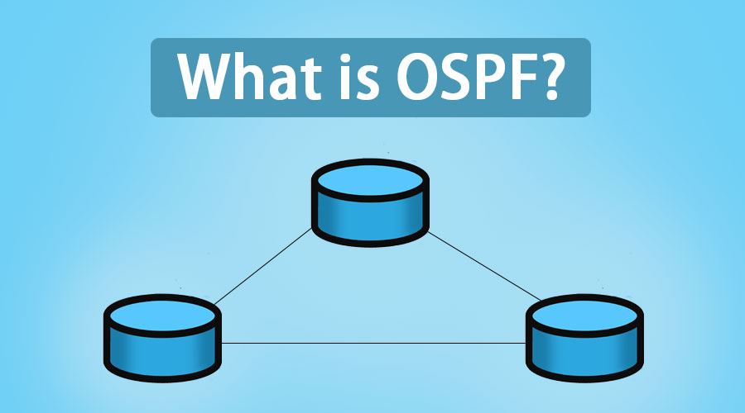

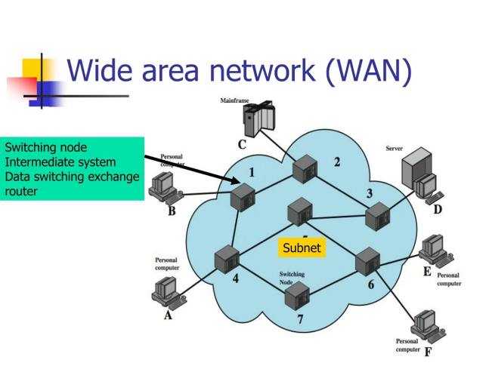

Slide 4
Introduction to Wide Area Networks (WANs)
Wide Area Networks (WANs) are telecommunication networks that span large geographic areas, often crossing regional or national boundaries. These expansive networks enable communication and data exchange between geographically dispersed devices, offices, and organizations.

Slide 5
Routing protocol
A routing protocol is a set of rules and algorithms that determine how data packets are forwarded from one network to another in a computer network. It helps in establishing communication between different networks by finding the most efficient path for data transmission.
Routing protocols are essential in the operation of large-scale networks, such as the internet, where data needs to be routed across multiple routers and networks. They enable routers to exchange information about network topology, network reachability, and the best paths to reach a destination.
There are various routing protocols available, each with its own set of features and characteristics. Some common routing protocols include OSPF (Open Shortest Path First), RIP (Routing Information Protocol), and BGP (Border Gateway Protocol).

Slide 6

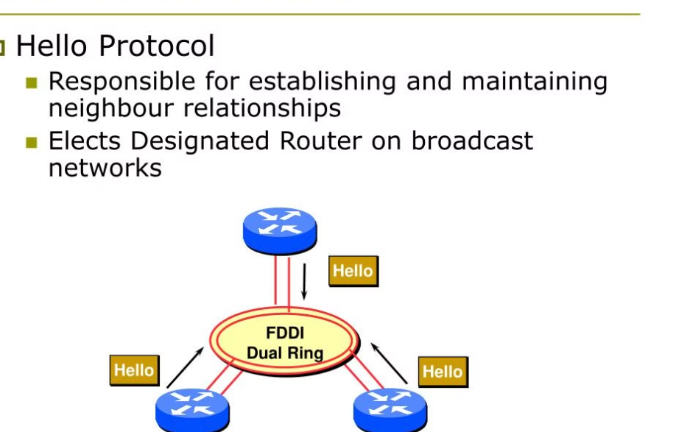
Overview of the OSPF (Open Shortest Path First) Protocol
OSPF is a dynamic routing protocol that utilizes the Link-State algorithm to determine the optimal paths within a network. It efficiently shares routing information between routers, allowing them to build a comprehensive map of the network topology.
OSPF is a widely-adopted protocol for enterprise and service provider networks due to its ability to converge quickly, support large-scale networks, and provide features like load balancing and fast failover.

Slide 7

OSPF Routing Concepts and Terminology
Link-State Algorithm: OSPF utilizes the Link-State algorithm to determine the optimal paths between routers based on the network topology.
Adjacencies and Neighbors: OSPF routers establish adjacencies and become neighbors to efficiently share routing information and build the network topology map.
🔍 OSPF Areas: Networks are divided into OSPF areas, which allow for hierarchical routing and reduce the complexity of the routing database.

Slide 8
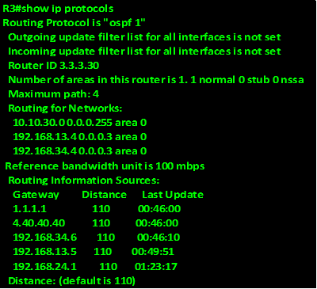
OSPF Troubleshooting Commands
show ip route
show ip ospf
show ip ospf database
show ip ospf interface

Slide 9
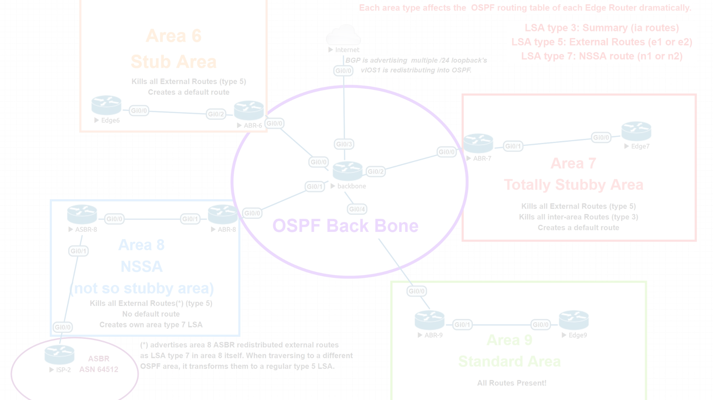
OSPF Network Types and Adjacencies
OSPF supports several network types, including point-to-point, broadcast, and non-broadcast multi-access (NBMA) networks. These network types impact how OSPF neighbors are formed and how routing information is shared.
OSPF routers establish adjacencies by exchanging Hello packets and reaching a mutually agreed state. Adjacencies allow routers to synchronize their link-state databases and participate in the OSPF routing process.

Slide 10
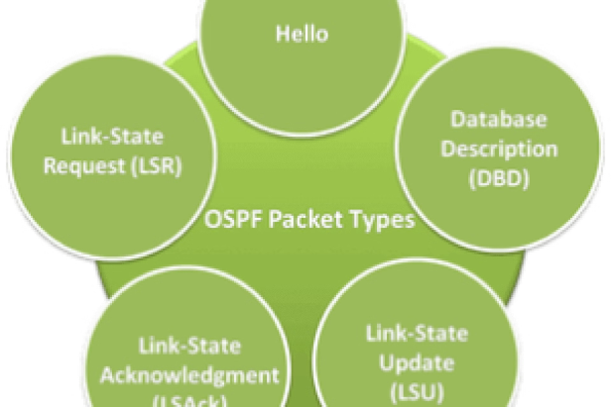
OSPF Packet Types and Neighbor Relationships
OSPF utilizes several packet types to establish and maintain neighbor relationships between routers. These include Hello packets, Database Description packets, Link-State Request packets, and Link-State Update packets.
OSPF neighbors exchange these packets to discover each other, synchronize their link-state databases, and share routing updates. Establishing and maintaining these neighbor relationships is crucial for the proper operation of the OSPF protocol.

Slide 11



OSPF Area Hierarchy and Route Summarization
Backbone Area (Area 0)
1
The central nervous system of the OSPF network.
Regular Areas
2
Interconnected with the backbone, these areas contain internal routing.
Stub Areas
3
Areas with limited or no external connectivity, optimized for efficiency.
OSPF organizes networks into a hierarchical structure of areas, with Area 0 serving as the backbone. This allows for more efficient routing and reduced complexity, as information can be summarized at area boundaries. Stub areas further optimize routing by limiting external routes, resulting in smaller routing tables.

Slide 12
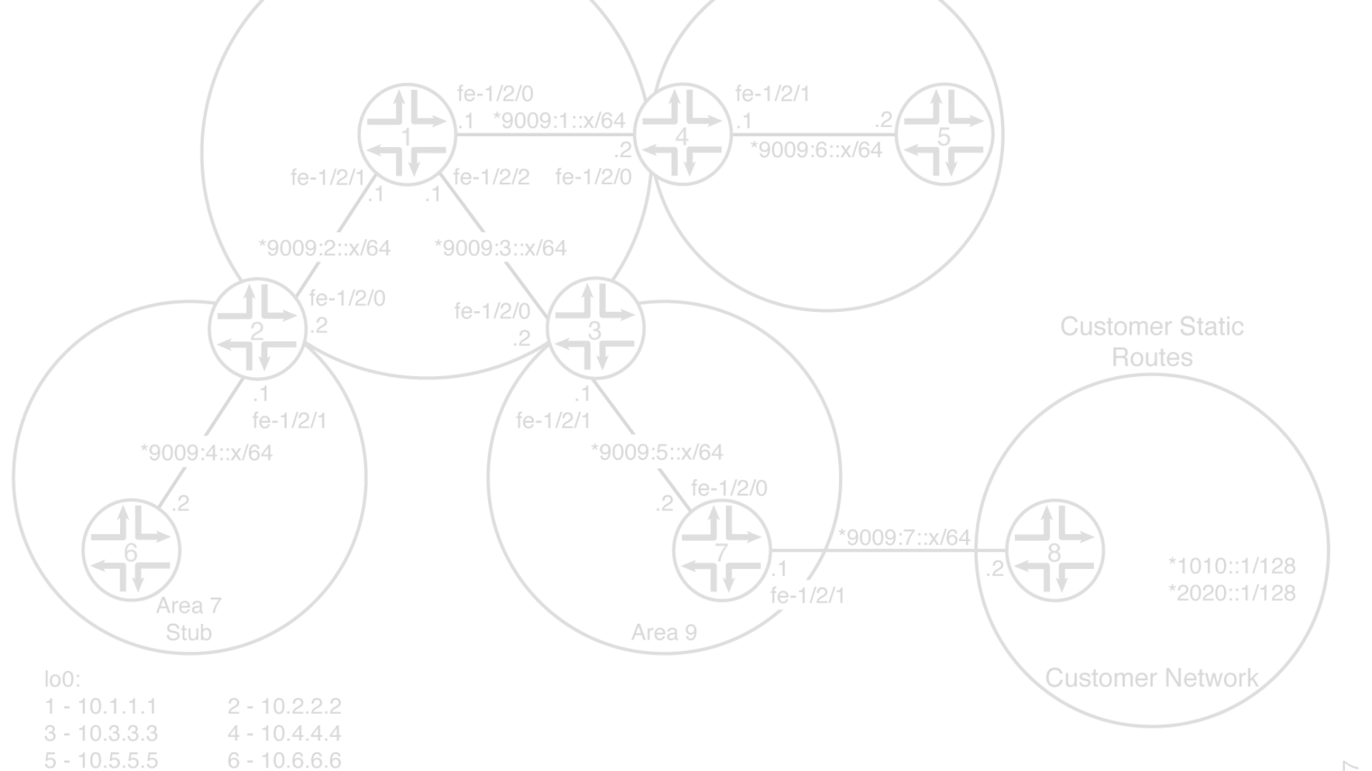
Designing an OSPF WAN Network Topology
1
Assess Network Scope
Evaluate the geographic reach, number of remote sites, and overall size of the WAN to determine the appropriate OSPF design approach.
2
Identify Key Locations
Determine the strategic locations for OSPF backbone routers, area border routers, and any specialized network devices.
3
Plan the Area Structure
Organize the network into a hierarchical OSPF area structure, with the backbone (Area 0) and supporting regular and stub areas.

Slide 13
Configuring OSPF on Routers and Switches
Router Configuration
Interface Configuration
Neighbors and Adjacencies
Switch Integration
Configure OSPF on routers by specifying the routing process, assigning interfaces to OSPF areas, and configuring timers and authentication. Use the "router ospf" command to enable OSPF and customize settings for optimal performance.
Assign each router interface to the appropriate OSPF area. This allows the interfaces to participate in the OSPF routing protocol and share topology information. Use the "ip ospf area" command to associate interfaces with areas.
Ensure OSPF neighbors form adjacencies by configuring timers and authentication. Use the "ip ospf hello-interval" and "ip ospf dead-interval" commands to control neighbor discovery and maintenance.
Configure OSPF on Layer 3 switches to enable routing capabilities. Assign switch interfaces to OSPF areas and configure the routing process. This allows switches to participate in the OSPF network and route traffic efficiently.

Slide 14
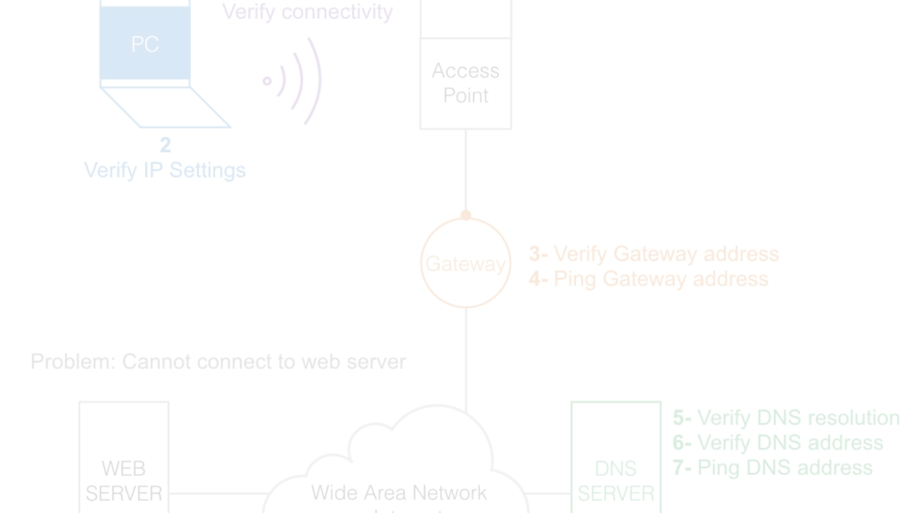
Troubleshooting and Monitoring OSPF Networks
1
Verify Adjacency Formation
2
Analyze the OSPF Database
Ensure OSPF neighbors are establishing adjacencies by checking the state of neighbor relationships and troubleshooting any issues with timers, authentication, or network types.
Inspect the OSPF link-state database to identify any inconsistencies, missing or incorrect routes, and ensure accurate topology information is being shared.
3
Monitor Routing Convergence
4
Troubleshoot Route Redistribution
Track the time it takes for OSPF to converge after network changes, ensuring the protocol is reacting promptly to keep the network optimized.
Identify and resolve any issues with redistributing routes from other routing protocols into the OSPF domain, maintaining comprehensive routing coverage.

Slide 15
Best Practices and Optimization Strategies for OSPF WANs
Network Segmentation
Summarization and Filtering
Divide the WAN into logical OSPF areas to improve scalability and reduce routing table sizes.
Leverage route summarization and filtering at area borders to simplify routing updates and conserve network resources.
Timely Convergence
Authentication and Security
Optimize OSPF timers and parameters to ensure rapid convergence after network changes for minimal downtime.
Implement strong authentication mechanisms to secure OSPF neighbor relationships and routing updates.

Slide 16
THE END

